Slide 1
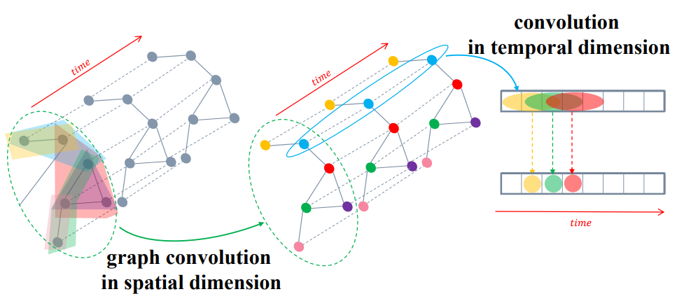
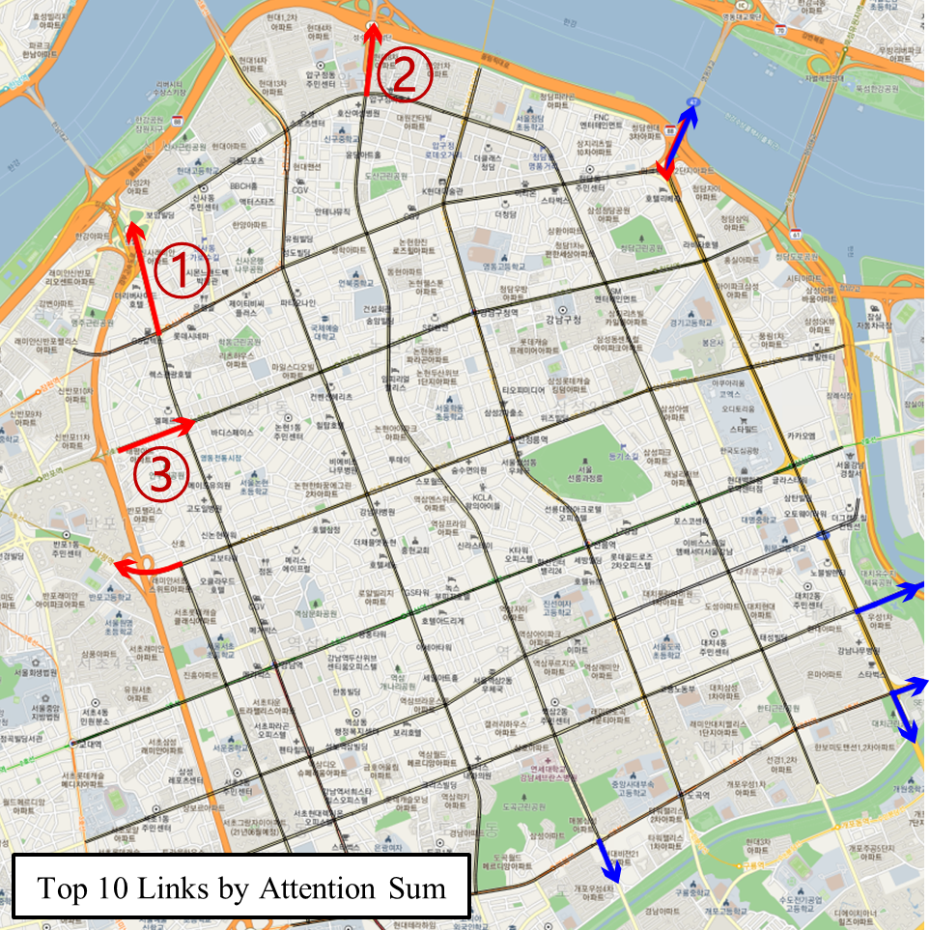
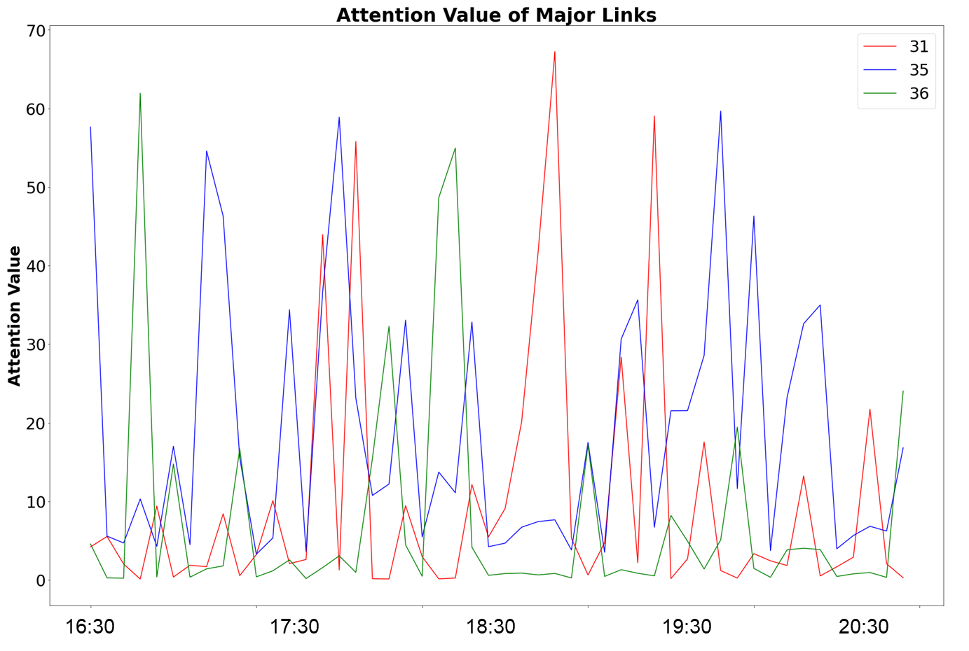
Real-time critical link selection in the urban road network congestion propagation Researcher: Ham Seung Woo
What is the problem?
The urban road network has a high dependency on each link. However, the existing linear models that illustrate the cause-and-effect(causality) relationship between links do not express these dependencies.
Existing methods of estimating mutual causality require extensive computational time because they need to check the mutual causality of every possible link pair. Since it is impractical to figure out which link pair will have a high dependency, pairwise computation is inevitable.
Existing models estimate the mutual causality based on the past data, not predicting the future via the prediction model.
Why is this problem important?
The congestion in the urban road network is getting severe as the city expands. Solving the congestion efficiently by properly arranged resources can reduce economic and environmental damage.
The current causality estimation model is impractical for the real-time ITS operation strategy alteration. The time and computational power consumption are intense to apply to the operation level.
The methodology of this study can be applied to various network propagation problems.
How can we solve this problem?
Proposed attention-based congestion propagation model can illustrate dependency between links
The result of this study enables real-time critical link selection by applying a deep learning-based model
The current model contains predictive ability, not only utilizing the past data
What is key contribution?
The proposed model can be used for real-time ITS operation strategy
The proposed model contains future prediction and mutual causality between links
Most of graph-based data can be a target situation of this model

